Slide 1
Searching with Cost
Dr. Deepti Chopra
*

Slide 2
Hill Climbing
Also called Discrete Optimization Algorithm.
Amount of distance the node is from the goal node.
The ordering of choice is a heuristic measure of the remaining distance one has to traverse to reach the goal node.
Same as DFS except that the children are sorted by remaining distance.
*

Slide 3
Hill Climbing is a generate and test algorithm.
Steepest Ascent Hill Climbing

Slide 4
Hill Climbing
Initialize: Take n = s
Fail:
  If There are no more states to traverse, Terminate with Failure
Terminate:
  If n ∈ G, terminate with SUCCESS
Expand:
  Generate the successors of n using O and sort them by the remaining distance from the goal node and select the one which has minimum value and call it n.
Loop: Goto step 2
*

Slide 5
A
6
4
Successors
A
B
C
45
5
3
2
3.5
E
F
G
H
I
J
J
*

Slide 6
A
6
4
Successors
A Visit A
C(4) B(6)
B
C
45
5
3
2
3.5
E
F
G
H
I
J
J
*

Slide 7
A
6
4
Successors
A Visit A
C(4) B(6) Visit C
H(2) G(3) I(3.5)
B
C
45
5
3
2
3.5
E
F
G
H
I
J
J
*

Slide 8
A
6
4
Successors
A Visit A
C(4) B(6) Visit C
H(2) G(3) I(3.5) Visit H
Goal Found
B
C
45
5
3
2
3.5
E
F
G
H
I
J
J
*

Slide 9
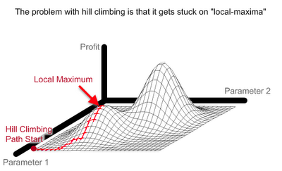
*

Slide 10
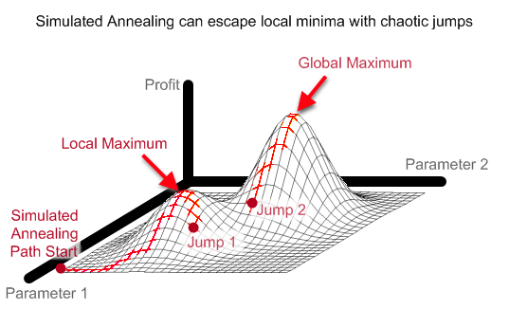
*

Slide 11
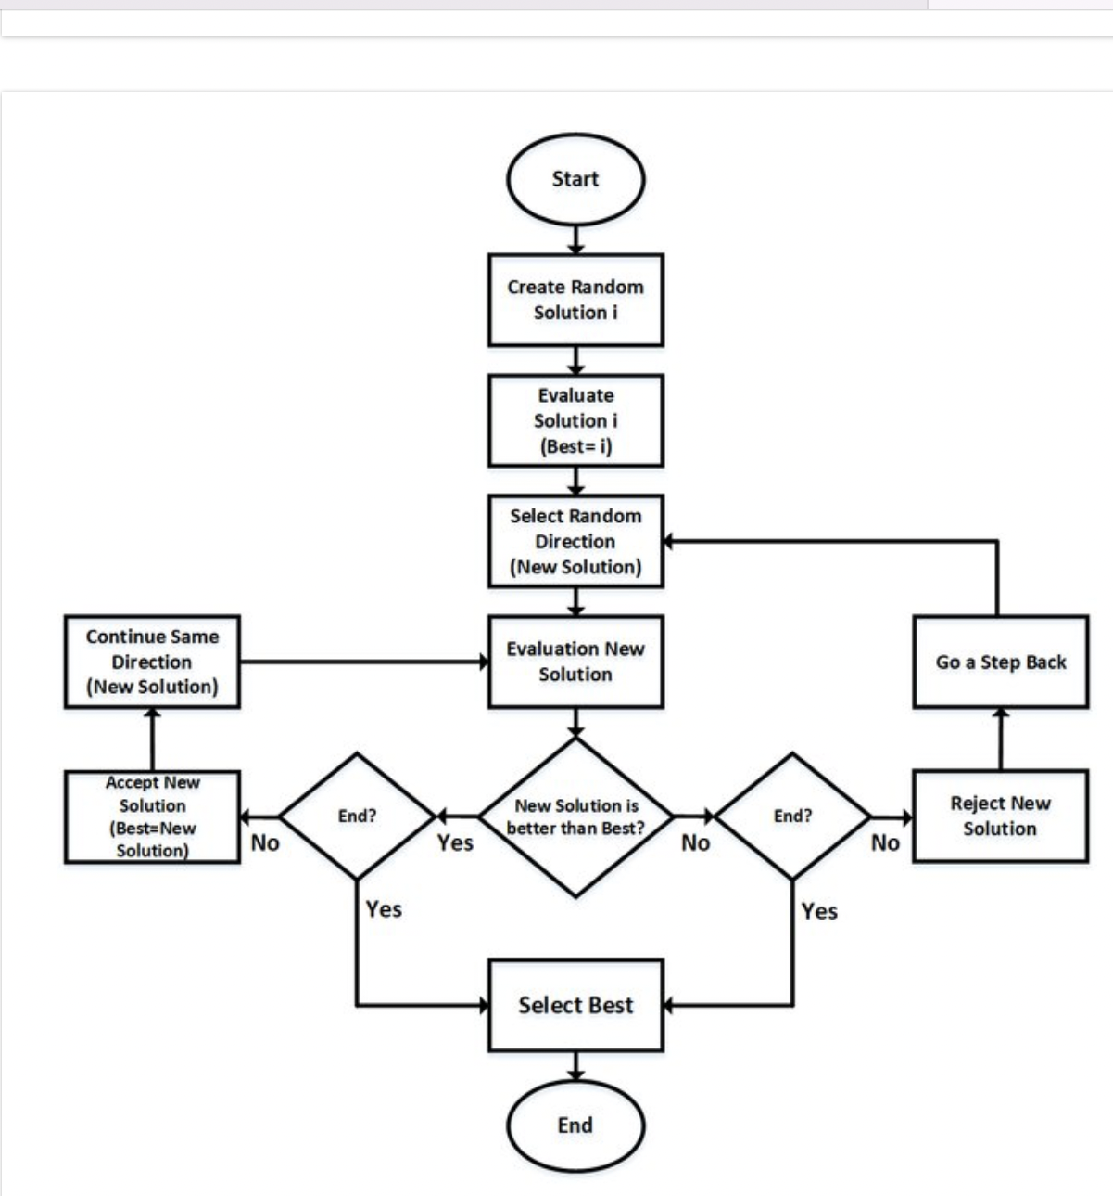

Slide 12
Uniform Cost Search
This algorithm assumes that all operators have a cost:
Initialize: Set OPEN = {s},
CLOSE = { }, Set C(s) = 0
Fail:
  If OPEN ={ }, Terminate with Failure
Select: Select the minimum cost state, n, form OPEN and Save n in CLOSE
Terminate:
  If n ∈ G, terminate with SUCCESS
*

Slide 13
Uniform Cost Search
Expand:
  Generate the successors of n using O. For each successor, m, insert m in OPEN only if m ∉ [OPEN ∪ CLOSE]
  set C(m) = C(n) + C(n,m)
  and insert m in OPEN
  if m ∈ [OPEN ∪ CLOSE]
  Set C(m) = min{ C(m), C(n)+C(m,n)}
  If C(m) has decreased and m ∈ CLOSE move it to OPEN
Loop: Goto step 2
*

Slide 14
2
1
2
1
2
3
4
3
1
1
3
5
1
5
5
6
7
8
1
4
10
15
8
3
1
9
10
11
12
*

Slide 15
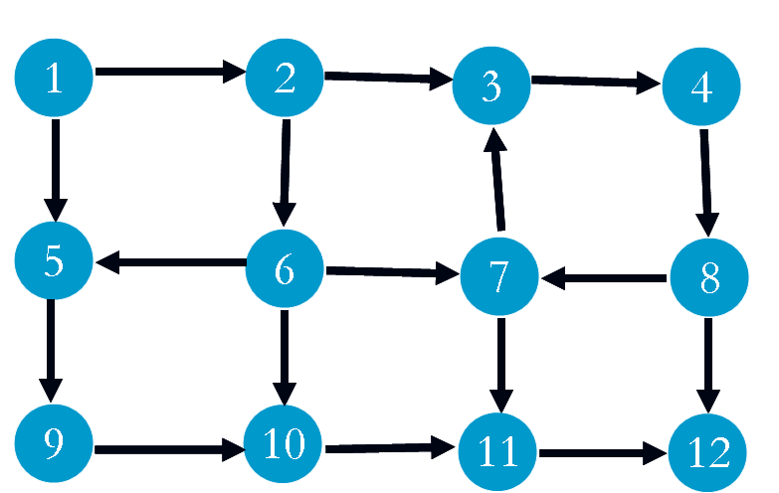
OPEN
1(0)
CLOSE
*

Slide 16
OPEN
1(0)
CLOSE
1(0)
*

Slide 17
OPEN
1(0)
2(2) 5(1)
CLOSE
1(0)
*

Slide 18
OPEN
1(0)
2(2) 5(1)
CLOSE
1(0) 5(1)
*

Slide 19
OPEN
1(0)
2(2) 5(1)
2(2) 9(2)
CLOSE
1(0) 5(1)
*

Slide 20
OPEN
1(0)
2(2) 5(1)
2(2) 9(2)
CLOSE
1(0) 5(1) 2(2)
*

Slide 21
OPEN
1(0)
2(2) 5(1)
2(2) 9(2)
9(2) 6(5) 3(3)
CLOSE
1(0) 5(1) 2(2)
*

Slide 22
OPEN
1(0)
2(2) 5(1)
2(2) 9(2)
9(2) 6(5) 3(3)
CLOSE
1(0) 5(1) 2(2) 9(2)
*

Slide 23
OPEN
1(0)
2(2) 5(1)
2(2) 9(2)
9(2) 6(5) 3(3)
6(5) 3(3) 10(10)
CLOSE
1(0) 5(1) 2(2) 9(2)
*

Slide 24
OPEN
1(0)
2(2) 5(1)
2(2) 9(2)
9(2) 6(5) 3(3)
6(5) 3(3) 10(10)
CLOSE
1(0) 5(1) 2(2) 9(2)
3(3)
*

Slide 25
OPEN
1(0)
2(2) 5(1)
2(2) 9(2)
9(2) 6(5) 3(3)
(6(5) 3(3) 10(10)
6(5) 10(10) 4(5)
CLOSE
1(0) 5(1) 2(2) 9(2)
3(3)
*

Slide 26
OPEN
1(0)
2(2) 5(1)
2(2) 9(2)
9(2) 6(5) 3(3)
(6(5) 3(3) 10(10)
6(5) 10(10) 4(5)
CLOSE
1(0) 5(1) 2(2) 9(2)
3(3) 6(5)
*

Slide 27
OPEN
1(0)
2(2) 5(1)
2(2) 9(2)
9(2) 6(5) 3(3)
(6(5) 3(3) 10(10)
6(5) 10(10) 4(5)
10(10) 4(5) 7(6) 10 (9)
CLOSE
1(0) 5(1) 2(2) 9(2)
3(3) 6(5)
*

Slide 28
OPEN
1(0)
2(2) 5(1)
2(2) 9(2)
9(2) 6(5) 3(3)
(6(5) 3(3) 10(10)
6(5) 10(10) 4(5)
4(5) 7(6) 10 (9)
CLOSE
1(0) 5(1) 2(2) 9(2)
3(3) 6(5) 4(5)
*

Slide 29
OPEN
1(0)
2(2) 5(1)
2(2) 9(2)
9(2) 6(5) 3(3)
(6(5) 3(3) 10(10)
6(5) 10(10) 4(5)
4(5) 7(6) 10 (9)
7(6) 10(9) 8(6)
CLOSE
1(0) 5(1) 2(2) 9(2)
3(3) 6(5) 4(5)
*

Slide 30
OPEN
1(0)
2(2) 5(1)
2(2) 9(2)
9(2) 6(5) 3(3)
(6(5) 3(3) 10(10)
6(5) 10(10) 4(5)
4(5) 7(6) 10 (9)
7(6) 10(9) 8(6)
CLOSE
1(0) 5(1) 2(2) 9(2)
3(3) 6(5) 4(5) 7(6)
*

Slide 31
OPEN
1(0)
2(2) 5(1)
2(2) 9(2)
9(2) 6(5) 3(3)
(6(5) 3(3) 10(10)
6(5) 10(10) 4(5)
4(5) 7(6) 10 (9)
7(6) 10(9) 8(6)
10(9) 8(6) 11(16)
CLOSE
1(0) 5(1) 2(2) 9(2)
3(3) 6(5) 4(5) 7(6)
*

Slide 32
OPEN
1(0)
2(2) 5(1)
2(2) 9(2)
9(2) 6(5) 3(3)
(6(5) 3(3) 10(10)
6(5) 10(10) 4(5)
4(5) 7(6) 10 (9)
7(6) 10(9) 8(6)
10(9) 8(6) 11(16)
CLOSE
1(0) 5(1) 2(2) 9(2)
3(3) 6(5) 4(5) 7(6) 8(6)
*

Slide 33
OPEN
1(0)
2(2) 5(1)
2(2) 9(2)
9(2) 6(5) 3(3)
(6(5) 3(3) 10(10)
6(5) 10(10) 4(5)
4(5) 7(6) 10 (9)
7(6) 10(9) 8(6)
10(9) 8(6) 11(16)
10(9) 11(16) 12(21)
CLOSE
1(0) 5(1) 2(2) 9(2)
3(3) 6(5) 4(5) 7(6) 8(6)
*

Slide 34
OPEN
1(0)
2(2) 5(1)
2(2) 9(2)
9(2) 6(5) 3(3)
(6(5) 3(3) 10(10)
6(5) 10(10) 4(5)
4(5) 7(6) 10 (9)
7(6) 10(9) 8(6)
10(9) 8(6) 11(16)
10(9) 11(16) 12(21)
CLOSE
1(0) 5(1) 2(2) 9(2)
3(3) 6(5) 4(5) 7(6) 8(6)
10(9)
*

Slide 35
OPEN
1(0)
2(2) 5(1)
2(2) 9(2)
9(2) 6(5) 3(3)
(6(5) 3(3) 10(10)
6(5) 10(10) 4(5)
4(5) 7(6) 10 (9)
7(6) 10(9) 8(6)
10(9) 8(6) 11(16)
10(9) 11(16) 12(21)
11(16) 12(21) 11(12)
CLOSE
1(0) 5(1) 2(2) 9(2)
3(3) 6(5) 4(5) 7(6) 8(6)
10(9)
*

Slide 36
OPEN
1(0)
2(2) 5(1)
2(2) 9(2)
9(2) 6(5) 3(3)
(6(5) 3(3) 10(10)
6(5) 10(10) 4(5)
4(5) 7(6) 10 (9)
7(6) 10(9) 8(6)
10(9) 8(6) 11(16)
10(9) 11(16) 12(21)
12(21) 11(12)
CLOSE
1(0) 5(1) 2(2) 9(2)
3(3) 6(5) 4(5) 7(6) 8(6)
10(9) 11(12)
*

Slide 37
OPEN
1(0)
2(2) 5(1)
2(2) 9(2)
9(2) 6(5) 3(3)
(6(5) 3(3) 10(10)
6(5) 10(10) 4(5)
4(5) 7(6) 10 (9)
7(6) 10(9) 8(6)
10(9) 8(6) 11(16)
10(9) 11(16) 12(21)
12(21) 11(12)
12(21) 12(13)
CLOSE
1(0) 5(1) 2(2) 9(2)
3(3) 6(5) 4(5) 7(6) 8(6)
10(9) 11(12)
*

Slide 38
OPEN
1(0)
2(2) 5(1)
2(2) 9(2)
9(2) 6(5) 3(3)
(6(5) 3(3) 10(10)
6(5) 10(10) 4(5)
4(5) 7(6) 10 (9)
7(6) 10(9) 8(6)
10(9) 8(6) 11(16)
10(9) 11(16) 12(21)
12(21) 11(12)
12(13)
CLOSE
1(0) 5(1) 2(2) 9(2)
3(3) 6(5) 4(5) 7(6) 8(6)
10(9) 11(12) 12(13)
*

Slide 39
Results
If all operator costs are positive, then the algorithm finds the minimum cost sequence of transition to a goal.
  No state will come back from CLOSE to OPEN
What happens when negative operator cost are allowed???
*

Slide 40
1
10
20
2
3
2
-15
4
15
5
*

Slide 41
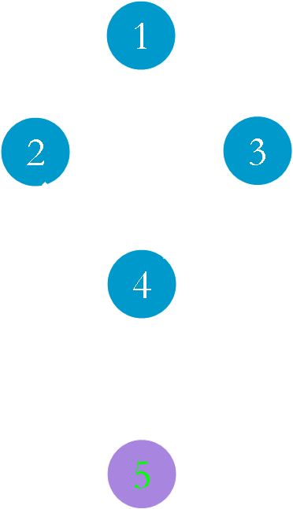
OPEN
1(0)
CLOSE
1(0)
*

Slide 42
OPEN
1(0)
2(10) 3(20)
CLOSE
1(0)
*

Slide 43
OPEN
1(0)
2(10) 3(20)
CLOSE
1(0) 2(10)
*

Slide 44
OPEN
1(0)
2(10) 3(20)
3(20) 4(12)
CLOSE
1(0) 2(10)
*

Slide 45
OPEN
1(0)
2(10) 3(20)
3(20) 4(12)
CLOSE
1(0) 2(10) 4(12)
*

Slide 46
OPEN
1(0)
2(10) 3(20)
3(20) 4(12)
3(20) 5(27)
CLOSE
1(0) 2(10) 4(12)
*

Slide 47
OPEN
1(0)
2(10) 3(20)
3(20) 4(12)
3(20) 5(27)
CLOSE
1(0) 2(10) 4(12)
3(20)
*

Slide 48
OPEN
1(0)
2(10) 3(20)
3(20) 4(12)
3(20) 5(27)
5(27) 4(5)
CLOSE
1(0) 2(10) 4(12)
3(20)
*

Slide 49
OPEN
1(0)
2(10) 3(20)
3(20) 4(12)
3(20) 5(27)
5(27) 4(5)
CLOSE
1(0) 2(10) 4(5)
3(20)
*

Slide 50
OPEN
1(0)
2(10) 3(20)
3(20) 4(12)
3(20) 5(27)
5(27) 4(5)
5(27) 5(20)
CLOSE
1(0) 2(10) 4(5)
3(20)
*

Slide 51
OPEN
1(0)
2(10) 3(20)
3(20) 4(12)
3(20) 5(27)
5(27) 4(5)
5(20)
CLOSE
1(0) 2(10) 4(5)
3(20) 5(20)
*

